Slide 1
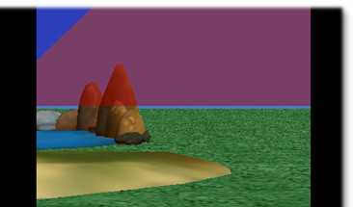
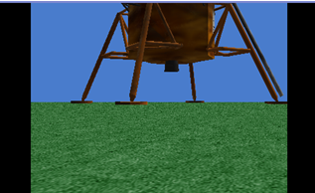
Scene changes
By Deborah Nelson
(thanks to Henry Qin for developing the Scene Change class.)
Duke University
Under the direction of
Professor Susan Rodger
July 2008

Slide 2
Overview
This tutorial teaches you
How to switch between different ground templates (example, from sand to water to space),
To do this, we will add a special ground (ground2) that has all the ground textures stored in it.
How to set up different scenes in different locations in your Alice world
How to fade out (go to black) and fade back in.

Slide 3
Load world
Open a new world, with any template
Save it in a directory that you can find again,
After you have opened the file go into the "Layout" mode by clicking on the green button Add Objects (toward the middle of screen)
Overview: creating scene changes, we will
Add objects
Drop dummy objects at camera positions
Write two methods for transition of fading in and out from scenes

Slide 4
Part One: Set up
Click more controls. Click drop a dummy at the camera.
In the object tree, expand the Dummy Objects folder. Rename the dummy ‘scene1.’ (by right clicking on it and selecting rename)
Go to the Environments folder in the gallery.
Scroll over to Oasis. Drag Oasis into the scene.
See the screenshot on the next slide for an illustration

Slide 5
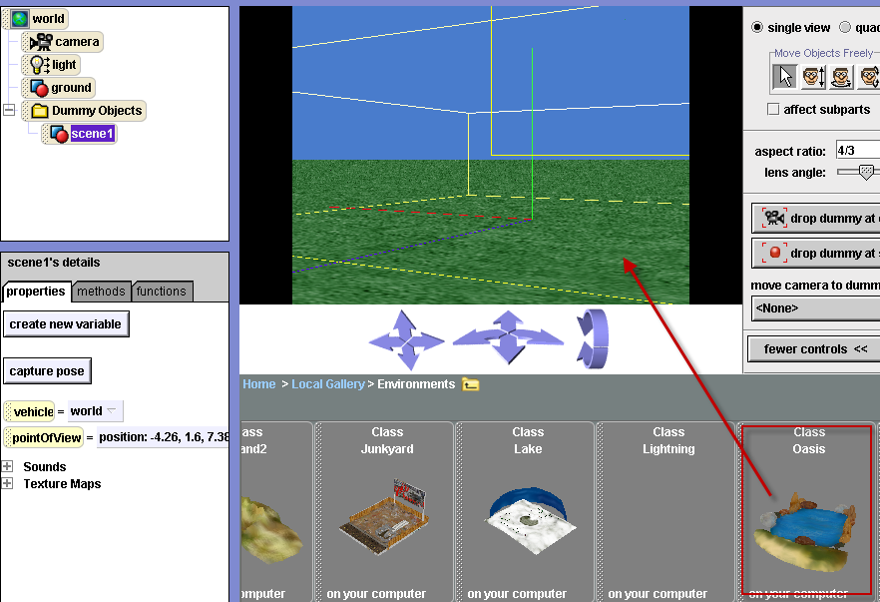

Slide 6
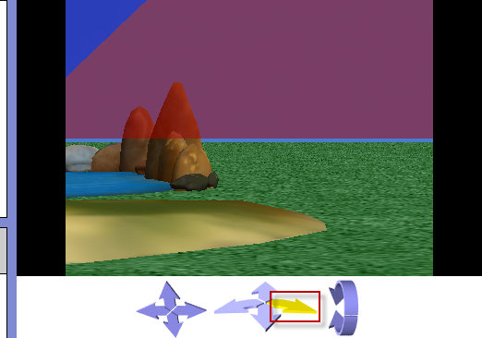
Move the camera over
Once the oasis is in your scene, use the camera position arrow to move the camera view, until you can no longer see the oasis

Slide 7
Drop dummy at camera
When you can no longer see the oasis, drop a dummy at the camera.
In the object tree, rename this dummy ‘scene2’
In the Environments folder, scroll over to Island Drag Island into the scene
See the screenshot on the next slide for an illustration

Slide 8
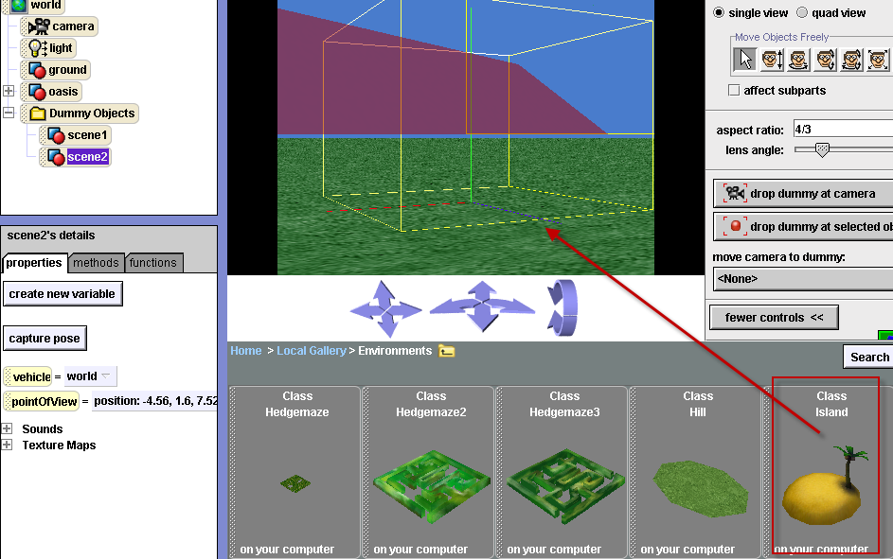

Slide 9

Move the camera over (to the right) until you can no longer see the island.
Drop a dummy at the camera
In the object tree, rename it “scene3”.
Go to the Space Folder

Slide 10
Drag lunarLander into the scene, but barely in.
Before you release the mouse to drop it into the scene, hold down the shift key on your keyboard. Continue to drag the obj.
If you’re on a PC, you will see the yellow bound box move up because shift makes your object move up as you drag it in
See the screenshot in the next slide for a illustration of where my lunarLander is positioned

Slide 11
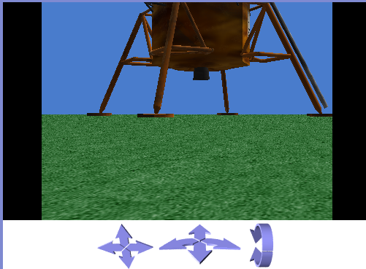

Slide 12
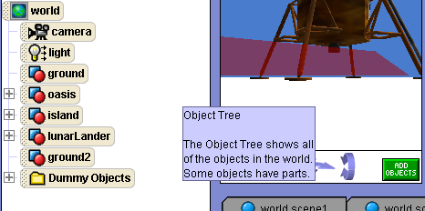
Import superGround.a2c
There is a superGround.a2c linked to the website you got this tutorial from. Save it in a directory you can find again
In Alice, Import the superGround.a2c by going to File – import.
It is ground2 in the object tree. The ground should be white now

Slide 13
Trouble with two grounds?
Having two grounds can cause problems, especially on a Mac. If you don’t see a white ground, then you may want to try to fix it in one of several ways.
Make the old ground invisible
OR delete the old ground (make sure no refs to it)
OR move the old ground down 200M out of site

Slide 14
Part Two:Writing methods
Click on the Done button to go back to the method editor
In the world detail pane, click world properties, then “create new variable”. (Essentially you are creating a new property)
Name the variable/property ‘storeAtmosphereColor’
Select type Other and select color, then click ok
Make another color variable. Name it ‘storeAmbientLightColor’.
See the screenshot on the next slide for an illustration

Slide 15
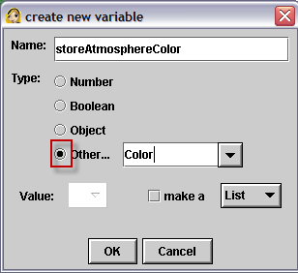
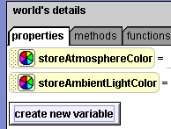
The color property variables

Slide 16
Write fadeOut method
Create a new world method named fadeOut
Drag in a do together from the bottom of the window
Click on the properties tab in the world details pane
Drag atmosphereColor into the fadeOut method. Set value to black
See the screenshot on the next slide for an illustration

Slide 17
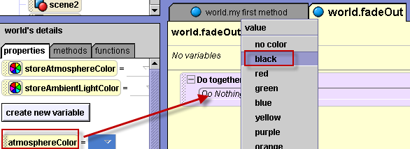
Resulting code:

Slide 18
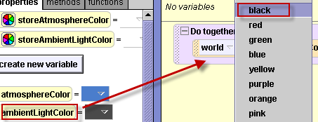

fadeOut Method (cont)
Drag ambientLightColor into the do together . Set value to black
Resulting Code:

Slide 19
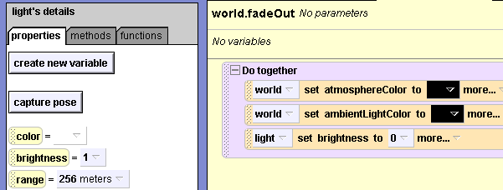
Click on the light object in the object tree. From the properties tab, drag brightness into the fadeOut method. Select Other and set value to 0
Here is the complete method:

Slide 20

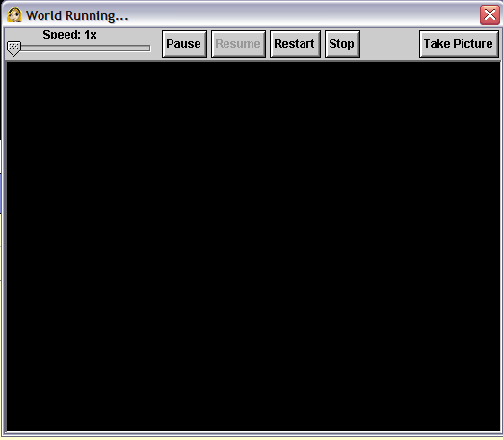
To test the fadeOut method, in the events panel, change the ‘myfirstmethod’ to fadeOut
Play your world
The screen should fade to be completely black

Slide 21
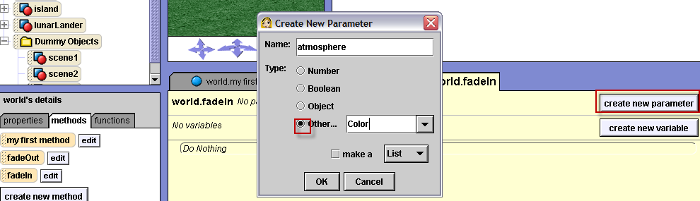
Write fadeIn method
Click on world in the object tree, then the methods tab in the world details pane. Create a new world method. Name it ‘fadeIn’
Click create new parameter in the method. Name it ‘atmosphere’. Select type color

Slide 22

Drag in a do together
Click on the properties tab in the world details pane.
Drag atmosphereColor into the fadeIn method. Set value to expressions, select the parameter, atmosphere.
Resulting code:

Slide 23
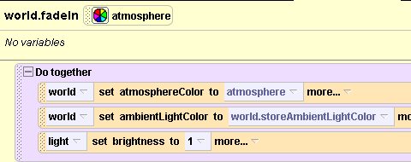
Drag “ambientLightColor” into the fadeIn method. Set value to expressions, select “storeAmbientLightColor”
Click on light in the object tree
In the properties tab, drag “brightness” into the method. Set value to 1.
Resulting code:

Slide 24
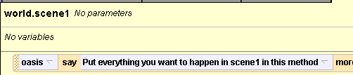
Write scene one method
Click on world in the object tree and click on the methods tab
Create a new method: name it scene1
Drag the Oasis’ “say” method into the scene1 method. Select Other and type – “Put everything you want to happen in scene1 in this method”

Slide 25
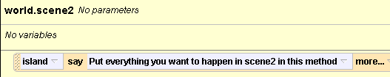
Write scene two method
Create new world method: name it scene2
Drag the Island’ say method into the scene2 method. Select Other and type – “Put everything you want to happen in scene2 in this method”

Slide 26
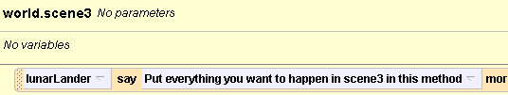
Write scene three method
Create new world method: name it scene3
Drag the Lunar Lander’s say method into the scene3 method.
Select Other and type – “Put everything you want to happen in scene 3 in this method”

Slide 27
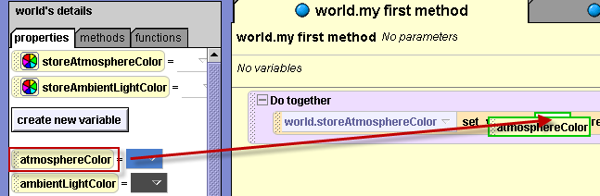
In world.my first method: Store the initial properties
Click on the world.my first method tab.
Drag in a do together
Drag the color property variable ‘storeAtmosphereColor” into the do together
Set value to “no color”. Drag atmosphereColor from the pane on to the blank.

Slide 28
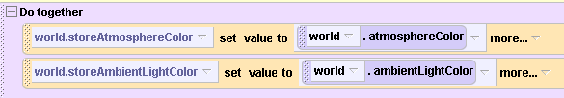
Store the initial propertie values
Drag the color variable “storeAmbientLightColor” into the do together and set value to “no color”.
Drag‘ambientLightColor” from the pane onto the blank
Resulting code:

Slide 29
Scene change: Camera
Click on the camera in the object tree
Drag the camera “set point of view to” method into the do together. Select Dummy Objects, select scene1

Slide 30
Scene change:Ground2
Click on ground2 in the object tree.
Drag it into the do together and select the “set skin texture to” method
Select ground2
Select SandTexture
See the screenshot on the next slide for an illustration

Slide 31
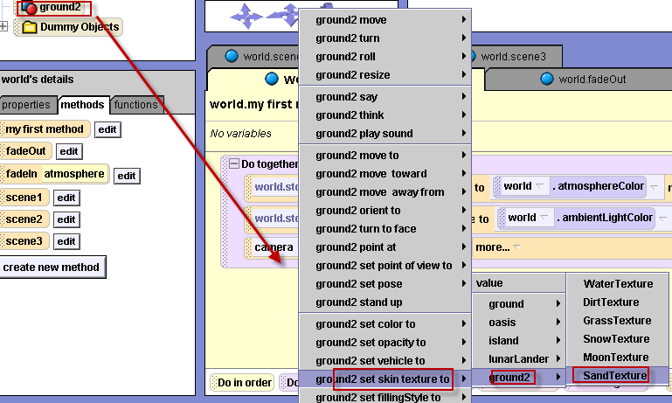
Resulting code:

Slide 32
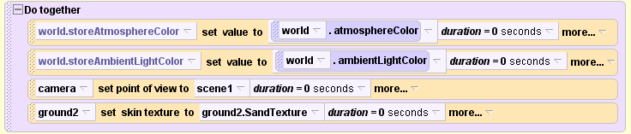
Set to Happen Quickly
This first code stores current atmosphere and ambient light colors, changes the camera to look at scene 1 and changes the ground texture to sand.
All this should happen instantly so the Alice world starts looking at the oasis on sand. To do this, add duration=0 to all four of the lines in the Do Together.

Slide 33


Click on the methods tab in the world details pane
Drag the scene1 method into world.my first method, underneath the do together
Then drag in the fadeOut method
To play your world, remember to change the event back to world.my first method

Slide 34

Drag in a new “do together” from the bottom of the window
In the “do together”:
Set the camera point of view to (dummy object) scene2
Set the ground2 skin texture to waterTexture

Slide 35

Underneath the do together, drag in the fadeIn method. For the parameter, select expressions, select the variable “storeAtmosphereColor”
Then drag in the scene2 method
Play your world

Slide 36
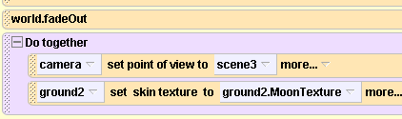
Drag in the fadeOut method underneath the do together
Drag in a new do together from the bottom of the window
In the do together:
Set the camera point of view to (dummy object) scene3
Set the ground2 skin texture to MoonTexture

Slide 37

Finish myFirstMethod
Underneath the “do together”, drag in the fadeIn method
For the parameter, select black (because the atmosphere is black in space)
Drag in the scene3 method
See the complete method on the next slide.
Play your world

Slide 38
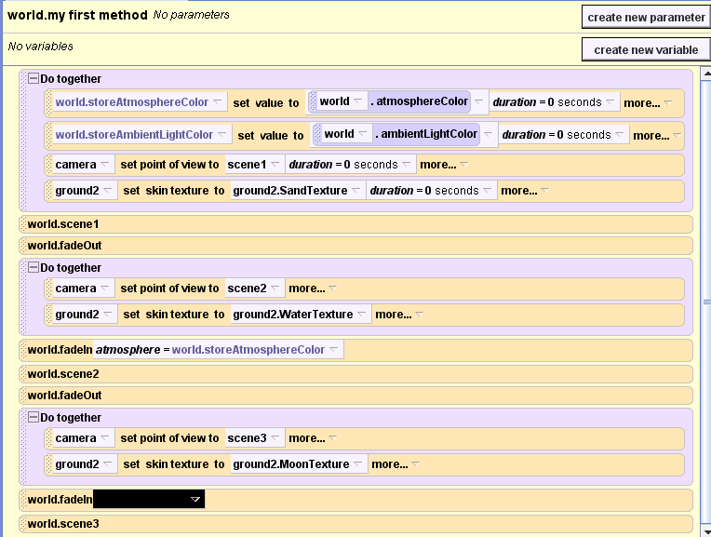

Slide 39
Recap
A fadeOut and fadeIn method are used for transitions
The camera position and ground texture are set for each scene
To simplify world.myFirstMethod, a separate method is written for each scene
This space scene is a little different than the others, always fadeIn with black. All other scenes need to fade in with the original atmosphere color.

